Slide 1
Getting Started with Python
ENGR 96A: Python and Machine Learning

Slide 2

What is Python?
From Python.org: “Python is an interpreted, object-oriented, high-level programming language with dynamic semantics.”
What this means
Python is used a lot
Data science
Back end development
Machine learning
What uses Python?

Slide 3
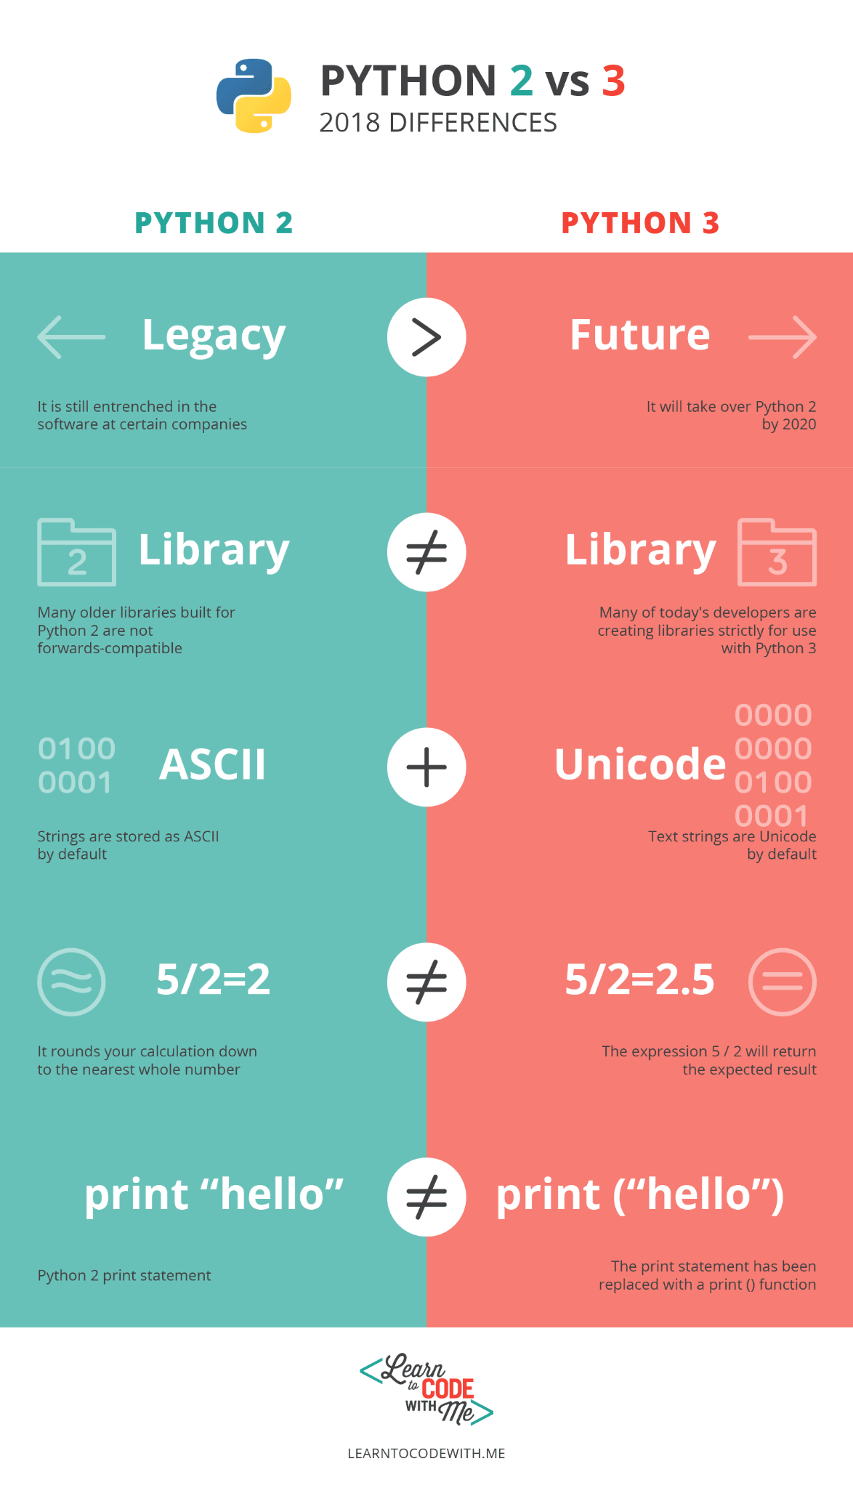
Python versions
Current version: 3.10
No longer supported: 2.7
Changes between Python versions

Slide 4



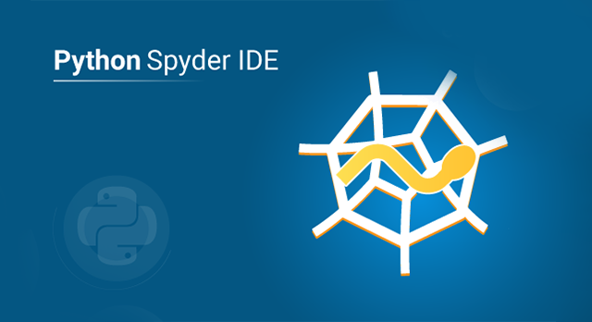

Writing and running Python
Many ways!
Editor + command line
Editor with built in run functions
Jupyter notebooks
This class: Google Colab Notebooks

Slide 5
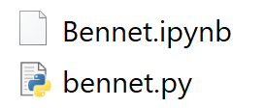
Python files
Python scripts use .py files
Notebooks use .ipynb files
Both are Python!

Slide 6
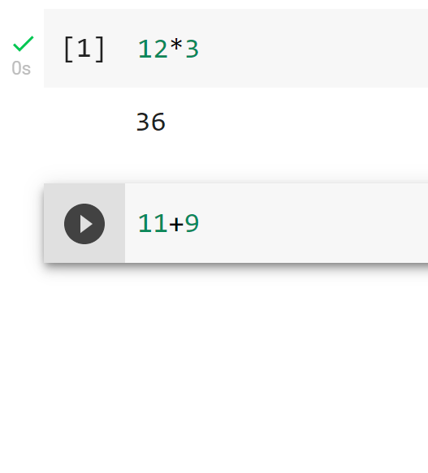
Why use notebooks?
Regular .py scripts run everything top to bottom
Notebooks are divided into cells

Slide 7
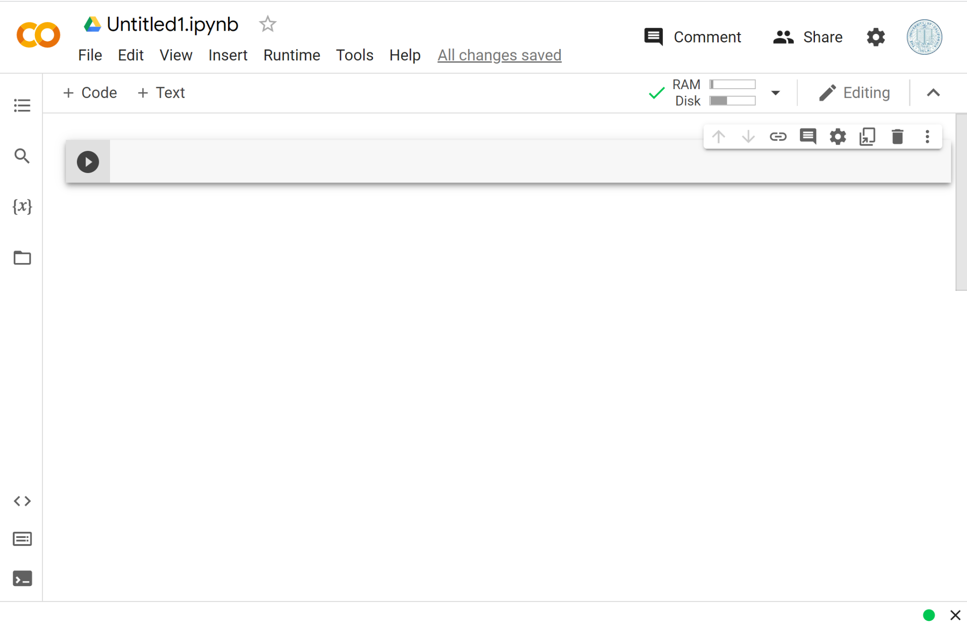
Introduction to Google Colab
Online notebook available for free
Uses Google’s resources instead of your own
Allows easy sharing
Quick timeout

Slide 8
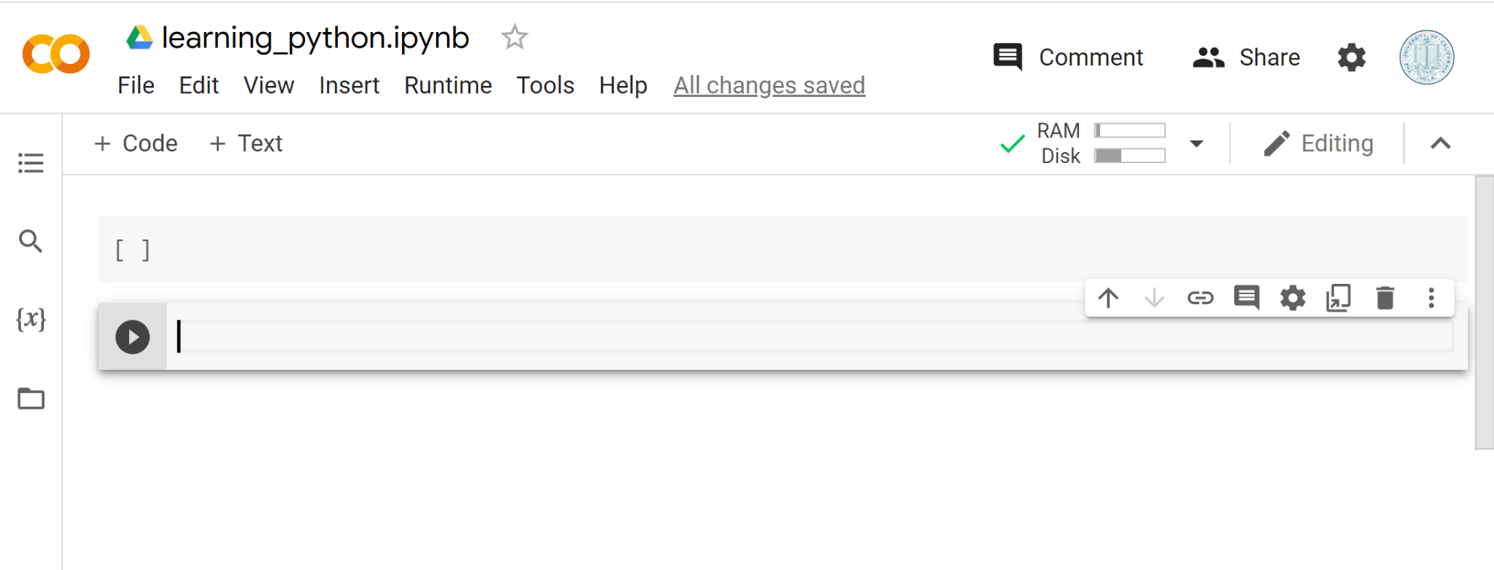
Adding cells

Slide 9
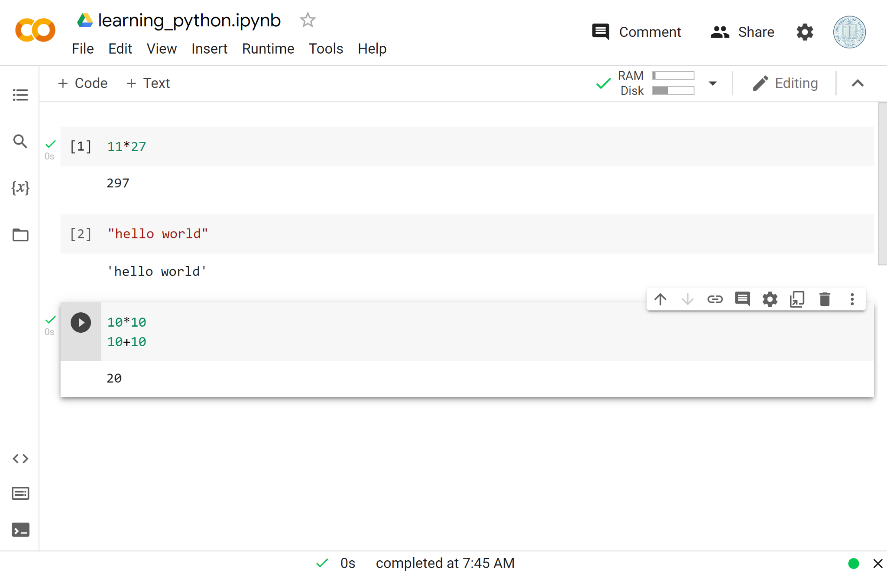
Colab printing

Slide 10
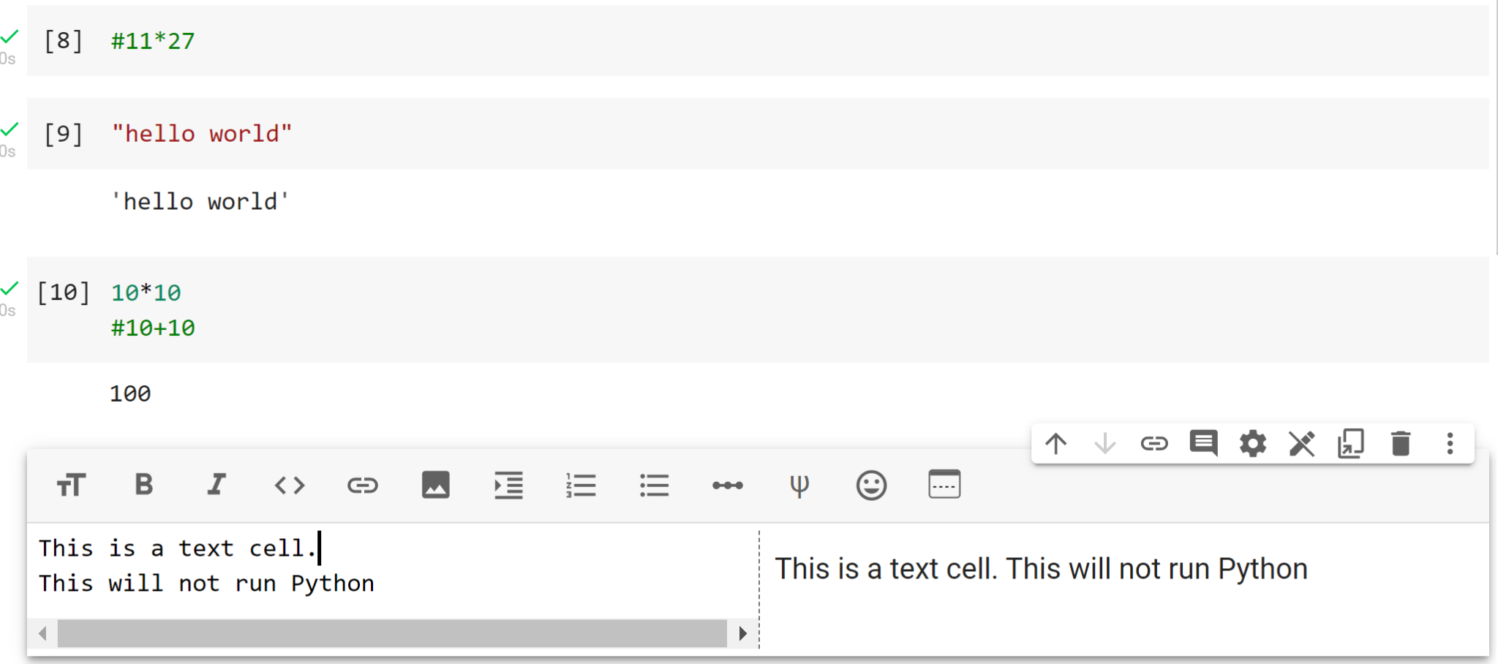
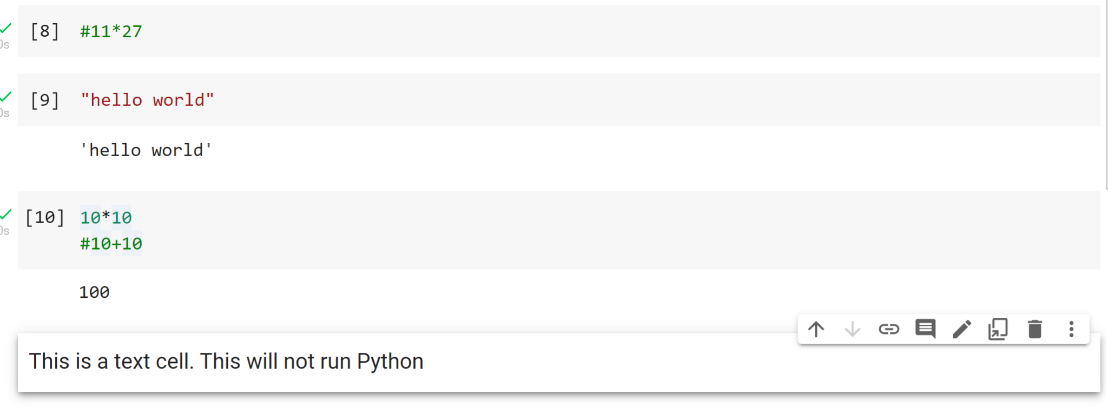
Comments and Text Cells
Comments #
Text cells do not run Python code

Slide 11
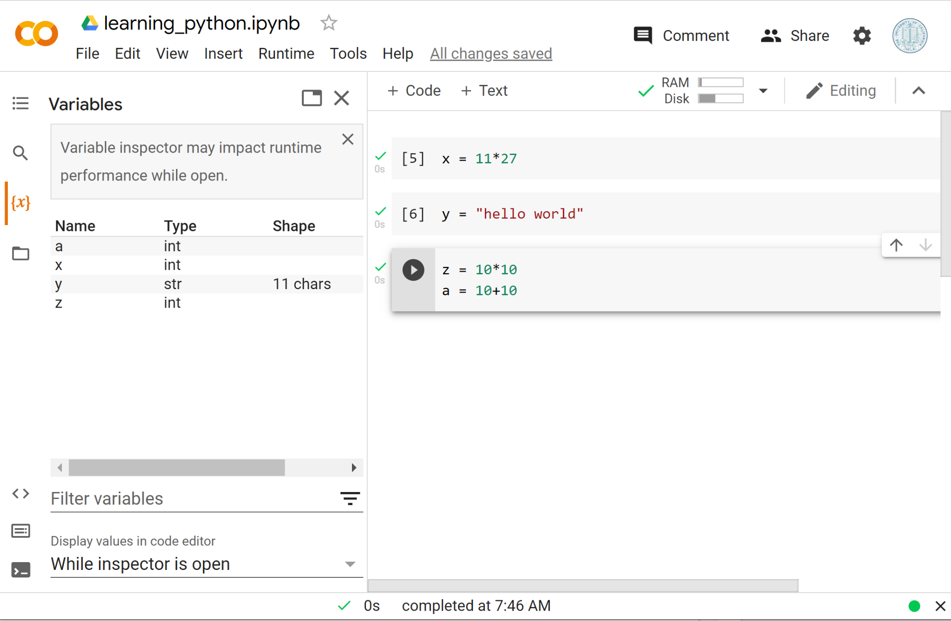
Saving variables

Slide 12
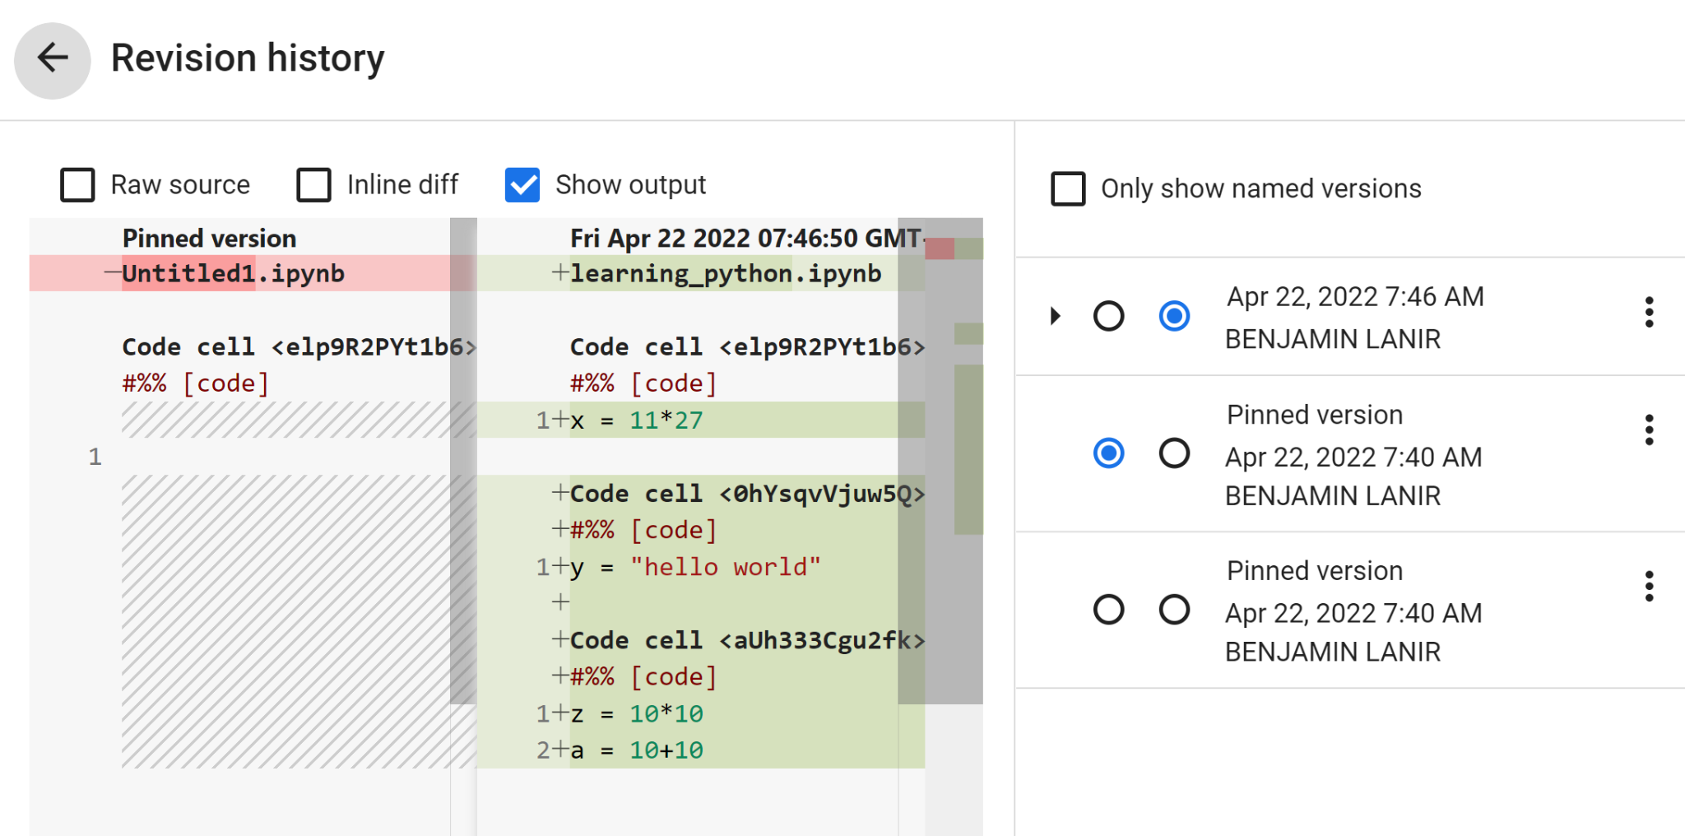
Colab saving

Slide 13
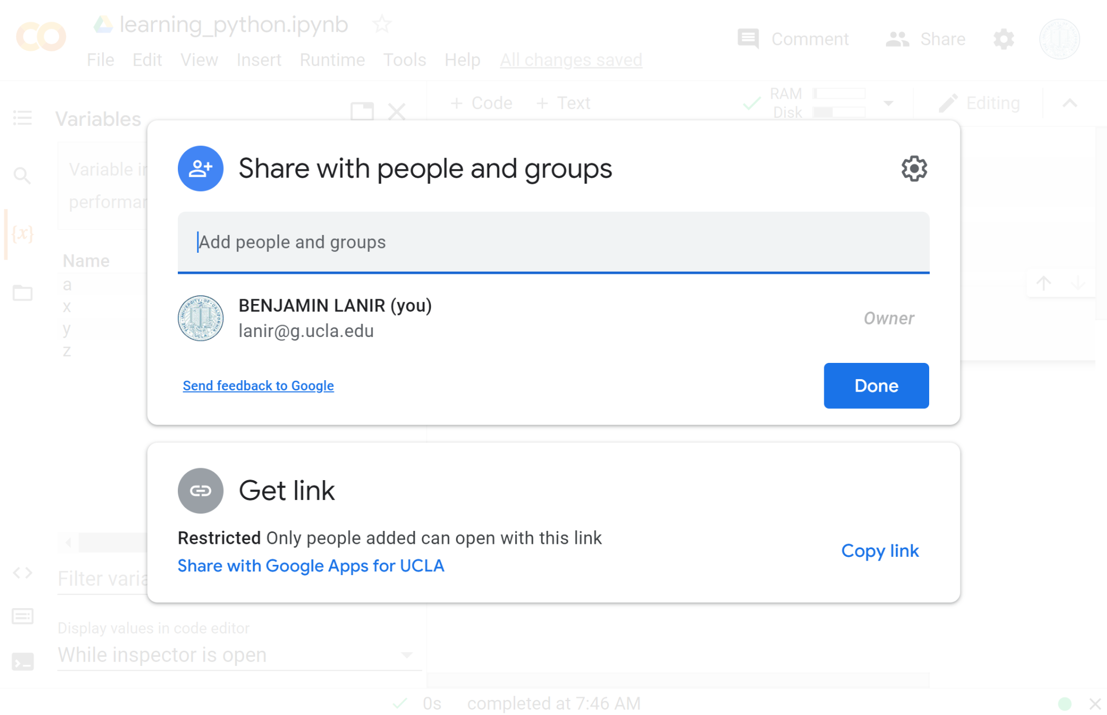
Colab differences from other Drive apps
No files transferred
Only one person may edit at a time

Slide 14
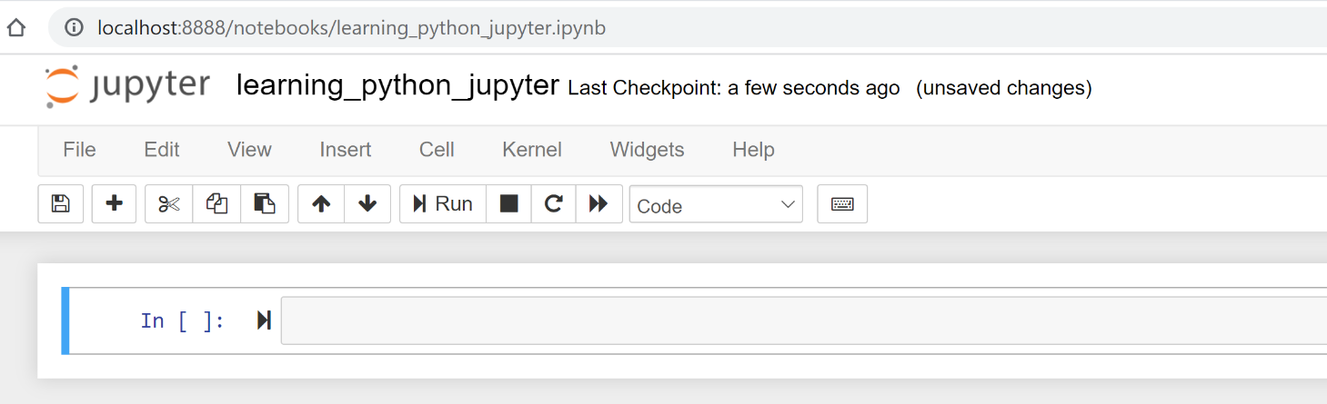
Option: Jupyter Notebooks
The project that Colab is built on top of
Run on your local machine
No timeout
No need to reload files

